Slide 1


Prototyping
Firebox-0
Nathan Pemberton Joao Carreira Zach Rowinski
Martin Maas Frank Nothaft
Krste Asanović Randy Katz

Slide 2
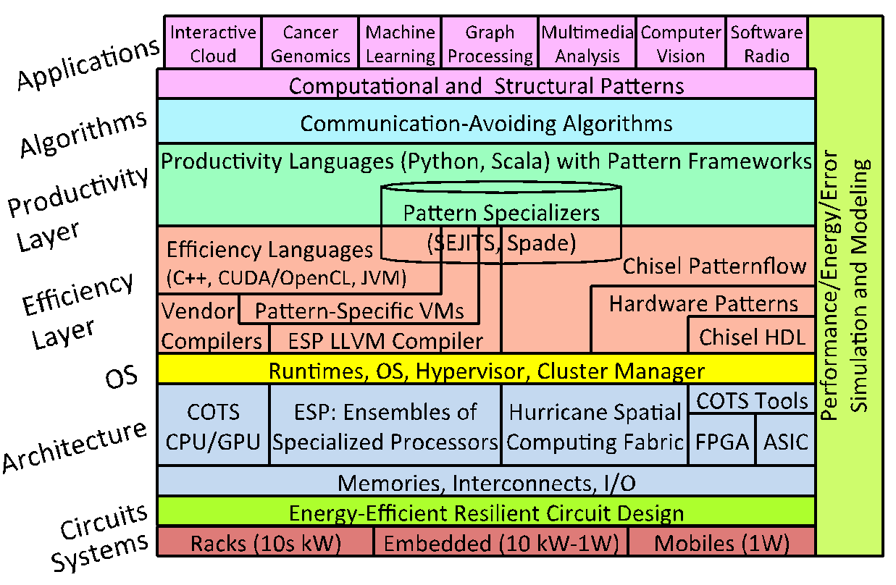
FireBox Stack
Notes:
Please put in notes here to explain poster so that someone else could summarize what your poster is about

Slide 3
This Talk
Firebox software stack spans multiple layers: from Apps to Racks
Talk :
Benchmarks of different layers of the stack – BITS (Berkeley Interactive Throughput Suite)
Early project building a new Xen-based hypervisor (XARCC)
Firebox Software Stack
Applications
and Services
Frameworks
and Runtimes
Resource Management
Hardware

Slide 4
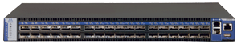
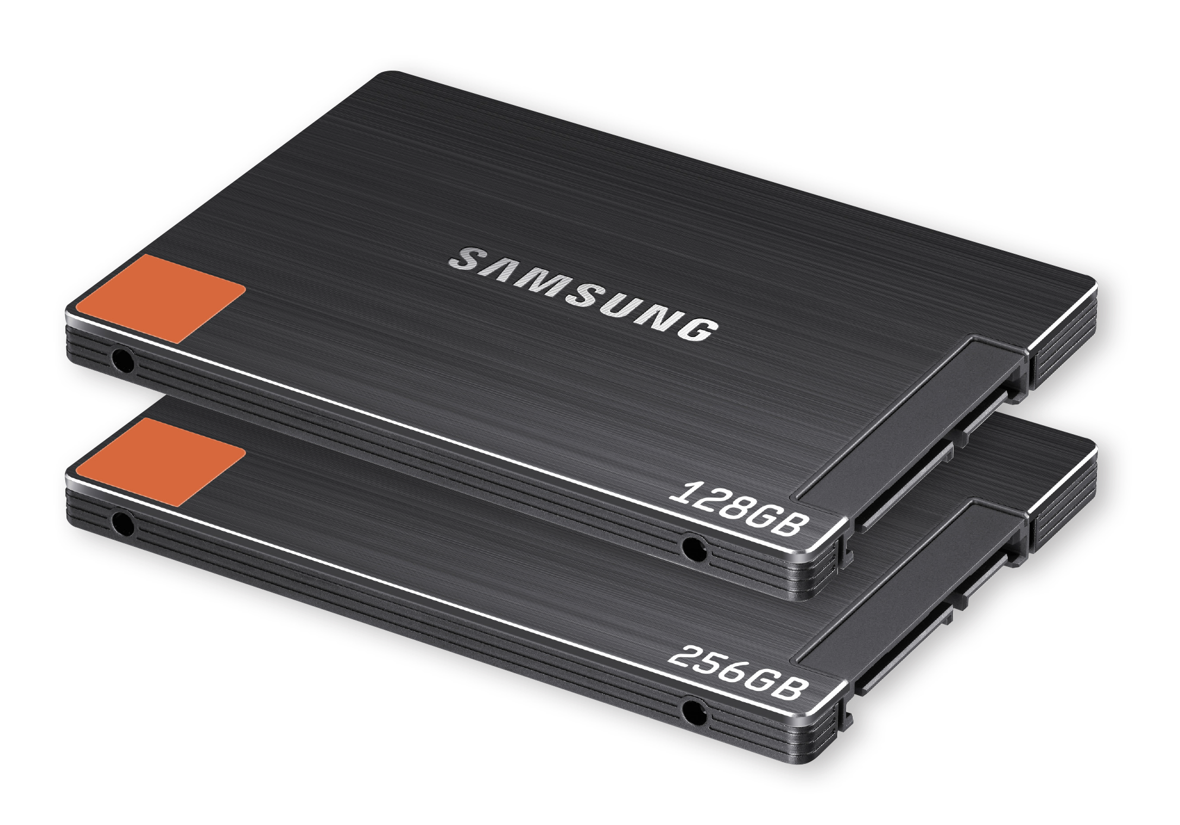
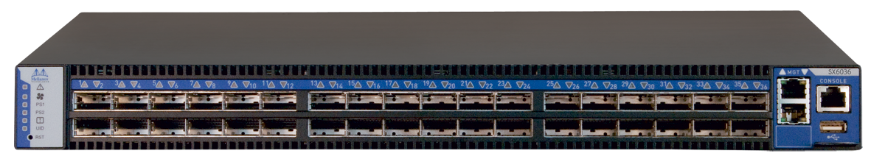
What is Firebox – 0?
Infiniband (Mellanox)
- Hardware configuration:
Intel Ivy Bridge E5-1680V2
8Cores / 16Threads 3.0GHz 25MB
64GB RAM per node (1TB aggregate)
2 Samsung SATA SSDs per node (120GB + 480GB) (9.4TB aggregate)
2 extra Samsung PCIe SSDs (734GB)
Infiniband: Mellanox ConnectX-3 VPI FDR QSFP 56Gbps
Ethernet: Mellanox ConnextX-3 EN QSFP 40Gb
Running Ubuntu 14.04 (Linux 3.13.0)
F1
F16
….
Ethernet (Mellanox)
Fbox

Slide 5
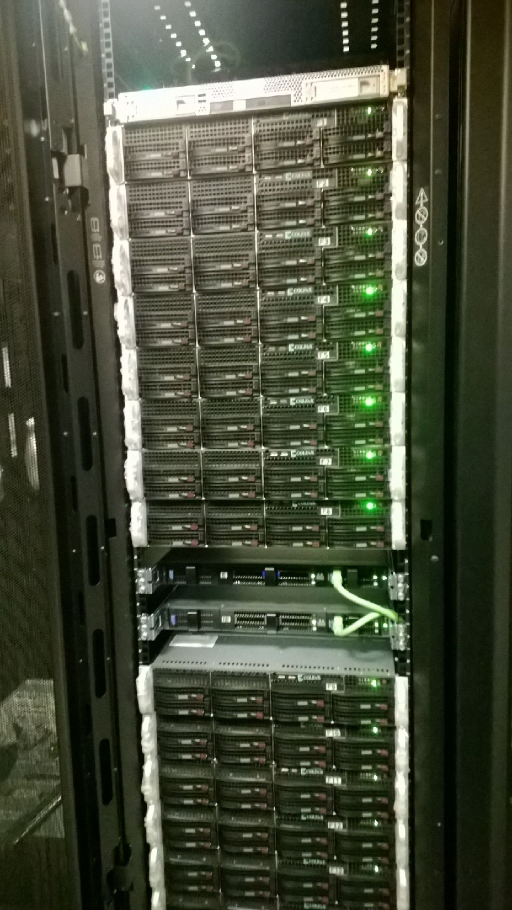
Firebox – 0: Goals
2014 state-of-the-art baseline using off-the-shelf hardware and software
platform to analyze current workloads
platform to develop new software stack ideas
host XAM-board prototype of Firebox bulk memory and networking
Notes:
Yardstick for new hardware
Understand bottlenecks of current HW

Slide 6
Outline
Apache Solr
Interactive Applications
Cluster Manager
RAMCloud, Aerospike,
Cassandra
Bulk Memory API
XARCC
“WSC Executive”
RDMA
Latency / Bandwidth
Network

Slide 7
Firebox-0 Network Latency / Bandwidth
RDMA Ping Pong Benchmark:
RDMA connection is setup
throughTCP/IP
Sequential RDMA reads with
different sizes
Latency:
Latency of 1.7us for small packets
High latency for big (>1MB) packets
Bandwidth:
Low bandwidth for small packets
Maximum bandwidth of ~5 GB/s

Slide 8
Firebox-0 Key-value stores
New component
Modified existing component
Interactive Applications
Cluster Manager (Mesos + interactive)
Bulk Memory API (RAMCloud + transactions)
“WSC Executive” (Xen + resource partitioning)
Network (Ethernet + Infiniband)

Slide 9
Benchmark of Key-value stores
Key-value stores benchmarked:
RAMCloud (RAM storage system with low-latency RPCs)
Aerospike (flash-optimized key-value store)
Cassandra (semi-structured and scalable key-value store)
Name | Atomicity / Consistency | Durability / Replication | Latency
RAMCloud | Atomic single-key updates. Supports conditional updates | Data is replicated to other nodes (RAM) and written to disk asynchronously | Ultra-low
Aerospike | Atomic single-key update Supports atomic multi-key reads | Data is replicated and written to disk sync/asynchronously | Low
Cassandra | Tunable / linearizable consistency No atomic writes across replicas | Data is replicated and written to disk sync/asynchronously | Low -Medium
Notes:
Key-value stores.
1) What is RAMCloud?
DRAM-based storage system
The case for RAMCloud
http://delivery.acm.org/10.1145/1970000/1965751/p121-ousterhout.pdf?ip=2.83.55.65&id=1965751&acc=OPEN&key=4D4702B0C3E38B35%2E4D4702B0C3E38B35%2E528120C21059793D%2E6D218144511F3437&CFID=551422919&CFTOKEN=31387118&__acm__=1420299996_3806cb8ae5b1fc2b0b8d8d4351f9242b
http://web.stanford.edu/~ouster/cgi-bin/papers/ramcloud-recovery.pdf

Slide 10
RAMCloud
ClusterPerf:
RAMCloud test suite (eg., multiReads)
We use one test (sequential read / write
of random objects)
RAMCloud:
4 nodes, replication factor = 0
Latency / Bandwidth:
67-107% higher read bandwidth
45-53% lower read latency
Challenges:
ACID multi-key transactions with
low-latency and at scale

Slide 11
AeroSpike + Cassandra (YCSB)
- YCSB:
32 concurrent clients from Firebox
- Aerospike and Cassandra setup:
4 nodes
Replication factor = 3
YCSB results:
Sub-millisecond average read latency for
both Aerospike and Cassandra
Aerospike with higher throughput for
Workload D (“read latest”) and
E (“short ranges”)

Slide 12
Interactive Applications on Firebox-0
New component
Modified existing component
Interactive Applications
Cluster Manager (Mesos + interactive)
Bulk Memory API (RAMCloud + transactions)
“WSC Executive” (Xen + resource partitioning)
Network (Ethernet + Infiniband)

Slide 13
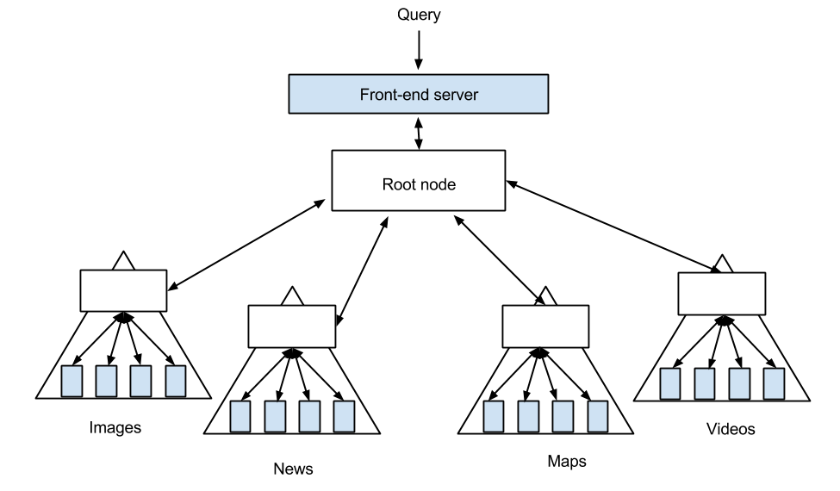
Benchmarking Distributed Search:
Apache Solr on Firebox-0
Distributed search architecture
Goal: Test latency sensitive (interactive) applications on Firebox-0
Apache Solr is a popular open source program for text search with widespread use
Fan-out pattern -- many machines piece together the search response for a user

Slide 14
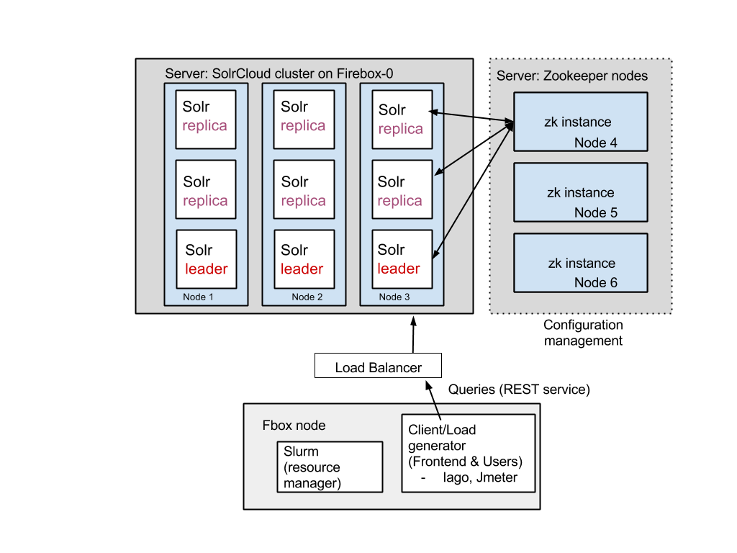
Solr on Firebox-0
Notes:
This is what Solr looks like on Firebox now
Solr cluster: 1 Solr instance -> 1 core. Data sharded evenly amongst instances and stored locally.
Zookeeper for cluster management.
Hadoop and HDFS (optional)
Solr on Firebox has two major components, the server and client. The server consists of a cluster of solr instances spread across many machines, together with a separate set of machines hosting Zookeeper. Zookeeper is responsible for cluster management and synchronization amongst the Solr instances; it knows if and when a node goes offline and communicates that to the Solr instances so they can reroute traffic accordingly. Each solr instances locally maintains a part of the index (shard) as well as maybe replicas.

Slide 15
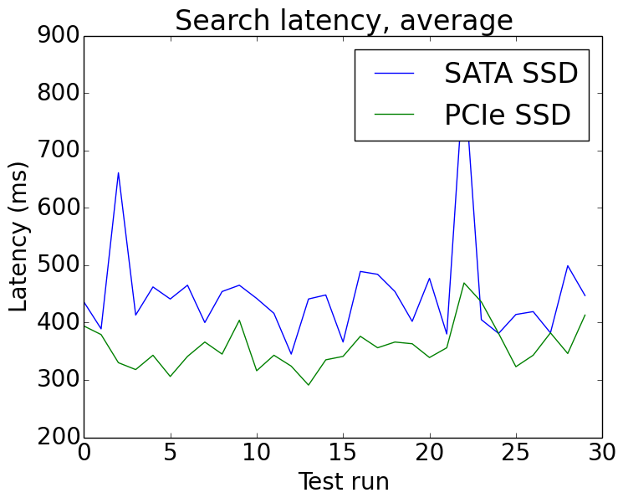
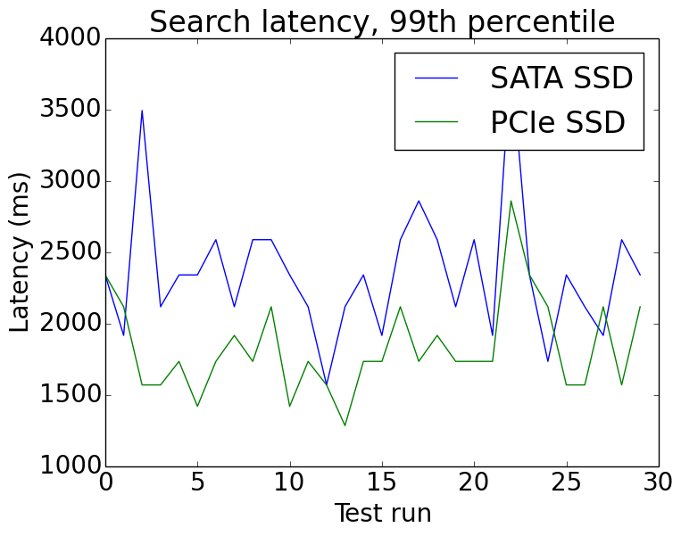
Experiment: Serving a large search index off of disk
Samsung 843T MZ7WD480 SATA vs. Samsung XS1715 PCIe 3.0 SSDs
2 shards, no replicas, 50 million indexed documents, 4 GB heap max, default GC settings
Test run
PCI-Express ~25% lower latency
Challenges benchmarking large distributed systems
Caching effects at the disk, OS, and program level have a significant impact on latency
Java GC is unpredictable - See Martin’s talk
many permutations of parameters to choose from for any given test
exogeneous factors that disrupt performance hard to find and diagnose
Notes:
This experiment is designed less for low latency or high query rate than it was to take advantage of disk bandwidth. You can see the PCIe SSD interface is roughly 25 % in this experiment. In this case, the Solr index is large (~30 GB a shard). It can fit in memory but suffers from high GC activity that kill latency performance.
What happens if attempt to keep search index on disk, rather than load it into memory...

Slide 16
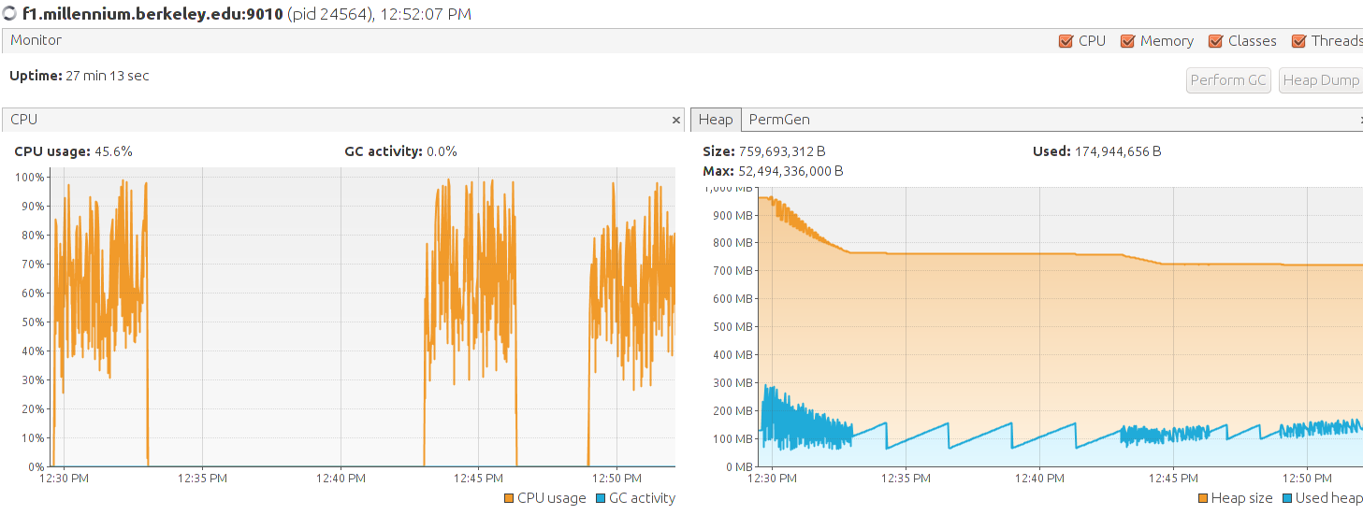
Testing Framework (BITS) - Berkeley Interactive and Throughput Suite
VisualVM: CPU and Memory monitoring
Python scripts for:
Setting up and taking down of application and data
Visualizing results with Matplotlib
Orchestrating tests & gathering data from tools
Makes use of common performance monitoring tools
Load generators: Iago, Jmeter.
CPU & Memory: VisualVM, Sematext SPM
Network: bwm-ng (coarse monitoring)
IO: iotop, dstat
Ganglia

Slide 17
Future Work
Benchmarks / Workloads:
A number of genomics and batch workloads are running on EC2, need to run on Firebox-0
Currently no benchmark at the “WSC Executive” layer
What other workloads to look at?
Aerospike vs Cassandra results:
Understand Aerospike / Cassandra performance on the D and E workloads (YCSB)
BITS:
Effort just getting started
There are other benchmarks / frameworks we can leverage

Slide 18
WSC Executive - XARCC
New component
Modified existing component
Interactive Applications
Cluster Manager (Mesos + interactive)
Bulk Memory API (RAMCloud + transactions)
“WSC Executive” (Xen + resource partitioning)
Network (Ethernet + Infiniband)

Slide 19
Motivation: Warehouse-Scale Computing
Large, multi-tenant computers for the cloud
Need dynamic resource allocations, resiliency to HW failure, power awareness
#1 Multi-tenancy:
* Lack of isolation and QoS * Resource Accounting
#2 Interactive applications:
* Latencies (Tail-tolerance) * Elasticity * Failures
#3 Low Utilization (3-17% EC2 [1]):
* No sharing for interactive jobs * Redundant OS, language runtime, etc. data structures
App
App
Hadoop
Spark
Linux + Cluster Manager (Mesos)
Custom Services
Hypervisor (Xen)
Linux
Batch Node
Batch Node
Interactive Node
10GBit Ethernet

Slide 20


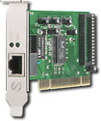
Prior ParLab Work: Tessellation
Adaptive Resource Centric Computing (ARCC)
Package applications into cells with explicit resource allocation and QoS guarantees
Manage cells and resource allocation through a thin control plane
Service-oriented
Cells subscribe to services provided by other cells
Service subscriptions == resource allocations
Resource
Assignments
Performance
Reports
Control
Plane
Running System
(Data Plane)
Application1
Application1
Cell
Cell
Channels
QoS-aware
Scheduler
QoS-aware
Scheduler
QoS-aware
Scheduler
GUI
Service
Block
Service
NW
Service

Slide 21
XARCC (aka Tessellation 2.0)
Observation: If the Tessellation kernel looks like a hypervisor, why not just use a hypervisor?
XARCC implements Tessellation concepts on top of Xen
Xen Domains become Cells
Pluggable Schedulers allow us to implement custom scheduling policies
Build network or other services in stub-domains (Xen domains intended to run drivers)
Run Linux or a custom Library OS in the cells instead of mandating a particular interface

Slide 22
XARCC
Traditional virtual-machine
approaches continue to work
Most cells run modified
OS and applications to take
full advantage of XARCC
features
Resource allocation broker provides QoS and ARCC policy
Traditional Cell
User App
Exec Framework
XARCC Cell
RAB
Service
Cluster Manager
User App
Linux
LibOS
Unified Inter-node
and Intra-node IPC
interfaces
XARCC (modified Xen)
Cell Scheduler
Resource Monitor
Cell Communication Channels
XARCC kernel
Provides QoS and ARCC mechanisms
Physical Node

Slide 23
XARCC Scheduling: Status and Experiences
Status: Implemented gang scheduler on Xen
Target performance predictability and synchronization overheads
Benchmarked with Micro-benchmark and HPC-oriented solid deformation simulation
Experiences
Micro-benchmark shows reduced variability when gang scheduling
Macro-benchmarks suffer from reduced CPU utilization
Takeaway: Tradeoff between utilization and predictability
Traditional Cell
User App
Exec Framework
XARCC Cell
RAB
Service
Cluster Manager
User App
Linux
LibOS
XARCC OS (modified Xen)
Cell Scheduler
Resource Monitor
Cell Communication Channels
Physical Node

Slide 24
XARCC Library OS: Status and Experiences
Status: Implemented stripped down OS for cells (CellOS)
Based on Guk¹ and newLib²
Supports a subset of POSIX
Ported Pthread based benchmarks
Experiences
Some single-application benchmarks are slower on CellOS than on Linux
Debugging is very difficult
Need to understand pros/cons better
Traditional Cell
User App
Exec Framework
XARCC Cell
RAB
Service
Cluster Manager
User App
Linux
LibOS
XARCC OS (modified Xen)
Cell Scheduler
Resource Monitor
Cell Communication Channels
Physical Node

Slide 25
Future Work
Still early days: Most features yet to be implemented
Resource Monitor
Dynamic Allocation Policies
Communication channels and service discovery
Run on FireBox-0 with BITS
Can current workloads take advantage?
Would custom HW change things?
Big area of interest: 2-level scheduling and resource allocation
Gang scheduling needs deeper analysis and more sophisticated implementation
Advantages of minimal OS vs Linux

Slide 26
Questions & Feedback
This work is in the early stages
Where would you like to see this go?
FireBox-0
BITS
XARCC

Slide 27
Backup Slides

Slide 28
Gang Scheduling Experiments
Micro-benchmark
Run identical, compute-bound tasks on multiple threads repeatedly
Record each time a thread completes its task more than a full iteration behind the others (a missed deadline)
Macro-Benchmarks
HPC benchmark that models solid deformation in extreme environments
Ran multiple instances of the benchmark
Batch: Each instance ran one after the other
Credit: Simultaneous execution on Xen’s default (non-gang) scheduler
Gang: Simultaneous execution with gang scheduling

Slide 29
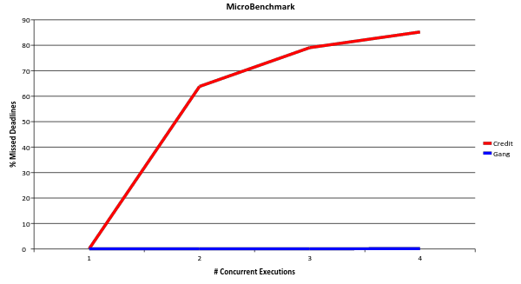
Micro Benchmark Results

Slide 30
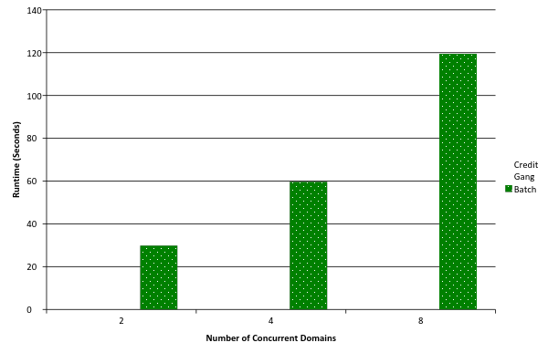
Macro Benchmark Results

Slide 31
Firebox Network
SockPerf Ping Pong Latency in Fbox
Without VMA* | 4.8 us
With VMA | 1.3 us
RDMA Ping Pong Latency
Firebox v0 | 1.7 us
RAMCloud HW [1] | 3.1 us
*VMA = Mellanox socket library with kernel bypass
Notes:
Raw benchmark of Firebox Network
TODO:

Slide 32
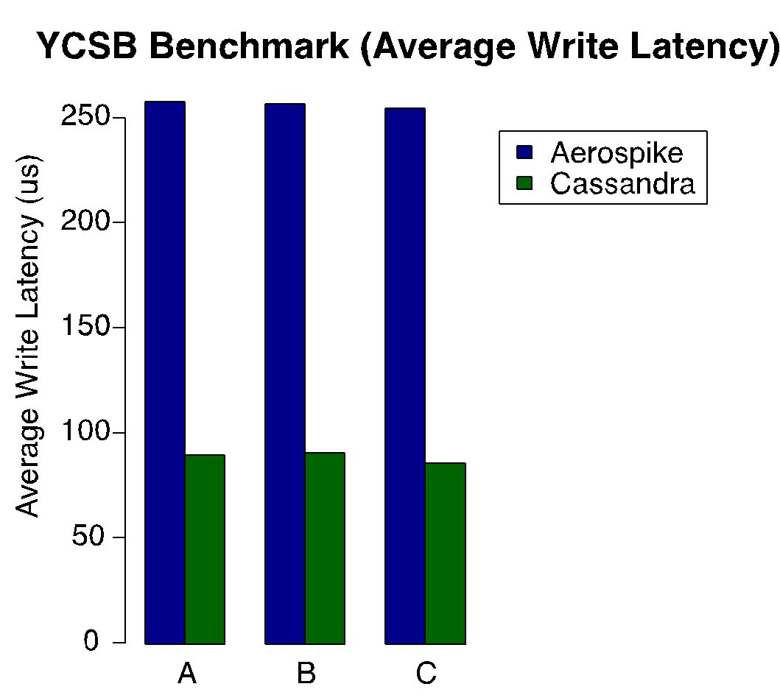
Aerospike/Cassandra Write Latency
Notes:
Raw benchmark of Firebox Network
TODO:

